Slide 1

Vijay Sankeshwar
“Founder of VRL Logistics Limited”

Slide 2

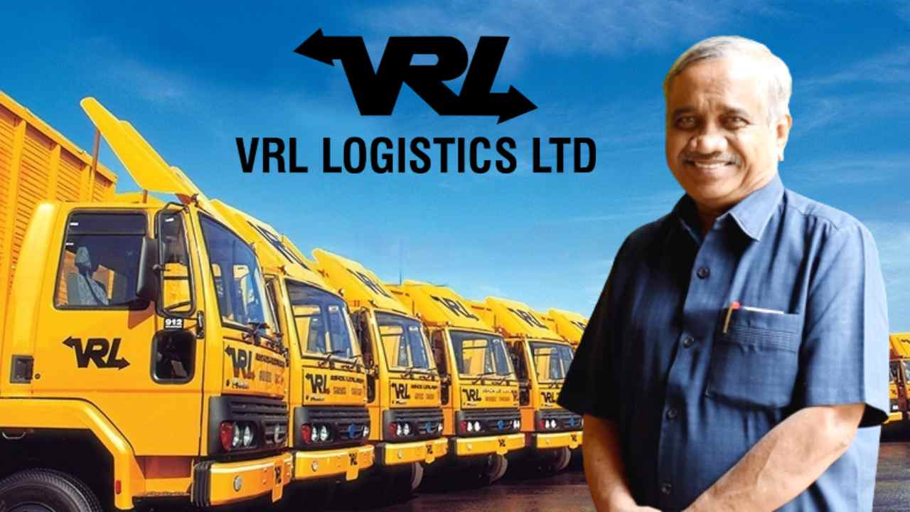
INDRODCTION
Brief overview of Vijay Sankeshwar's background and achievements
"Vijay Sankeshwar's journey to success was not without its challenges and failures."

Slide 3
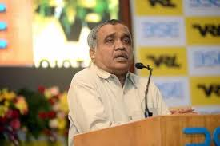
Born in 1954 in Hubli, Karnataka, India
Started his career in the transport industry with a single truck
- Expanded his fleet and ventured into logistics

Slide 4
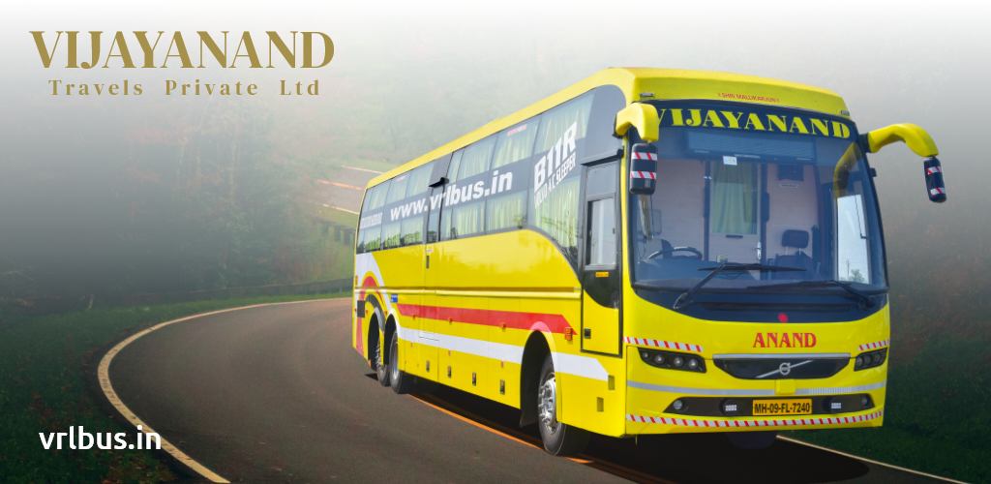
Founded VRL Logistics Limited in 1976
Grew the company into one of India's largest logistics companies
Transformed Vijay Road Lines (VRL) into one of India's largest transport companies, operating both passenger buses and cargo services.
VRL Travels operates a fleet of over 1,000 buses. This makes it one of the largest privately-owned bus operators in India.
The family transport business, which was started by his father. Over time, he took charge of the business and expanded it significantly.

Slide 5

The owner of Vijay Karnataka, a leading Kannada daily newspaper, and the India Today Group's newspaper venture.
Vijay Sankeshwar started publishing the Vijay Karnataka newspaper in 1999.
The success of Vijay Karnataka was unprecedented, and it became one of the leading Kannada dailies in the country.

Slide 6
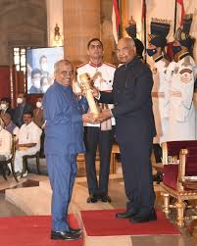
Awards and Recognition
"Logistics Man of the Year" award in 2014.
Vijay Sankeshwar was awarded an honorary Doctorate (Doctor of Letters, D.Litt.) by Kuvempu University, located in Karnataka, India at 2011
Vijay Sankeshwar was awarded the Padma Shri by the Government of India in 2021 for the fields of journalism, media, and business
Other notable awards and recognition

Slide 7

In the early days of Vijay Road Lines (VRL), the transportation business wasn't always smooth. Vijay Sankeshwar faced financial difficulties and operational hurdles in growing the company.
Challenges in scaling TV channels and media businesses, leading to some unsuccessful ventures.
Handling regulatory, safety, and administrative issues within his vast businesses.

Slide 8

success is not a straight path
failure is an integral part
of the journey to success
Thank you
Presentation By:
Jagadish W

